Slide 1
Offline Handwritten Text Summarization Tool
BY :-
JAYAM SOGANI
APRATIM PHADKE
PRANAV CHAUDHARI
HITESH PATIL
From Ink to Intelligence, Instantly and Privately

Slide 2
what are we going to do?
DATA COLLECTION AND OCR MODEL SELECTION
INTEGRATE OCR AND NLP INTO EXECUTABLE
TESTING AND EVALUATION
UI DEVELOPMENT
PREPROCESSING INPUT
NLP MODEL SELECTION AND FINE TUNING

Slide 3
NLP Model (Summarization)
OCR System
Input (Images, PDFs, Text)
End TO END WORKFLOW
Output Display on UI

Slide 4
TECHNOLOGY STACK
OCR Engine: Tesseract, EasyOCR (fine-tuned for handwriting)
NLP Models: PEGASUS/BART for summarization
Backend: Python (for NLP and OCR integration)
UI Framework: Tkinter or Electron for lightweight interface
Optimization: TensorFlow Lite for running models on low-resource devices

Slide 5
Input Preprocessing
Steps for Image Processing:
1.Grayscale conversion
2.Noise reduction using Gaussian filters
3.Image alignment with OpenCV

Slide 6
Summarization Algorithm
Model: PEGASUS / BART
Algorithm Workflow:
Input text
Noise removal
3.Identifying key sentences
4.Generating summary with high coherence
Metric: BLEU/ROUGE score to measure summarization accuracy.

Slide 7
OCR Model & Metrics
OCR Model: Tesseract/EasyOCR (Fine-tuned on handwriting datasets)
Evaluation Metrics:
CER (Character Error Rate): Targeting 5-7
WER (Word Error Rate): Targeting 15%-25%

Slide 8
Offline Functionality
How We Achieve Offline Operation:
Pre-load models and libraries during installation.
No API calls or dependency on servers.
Models run locally with optimized memory usage.

Slide 9
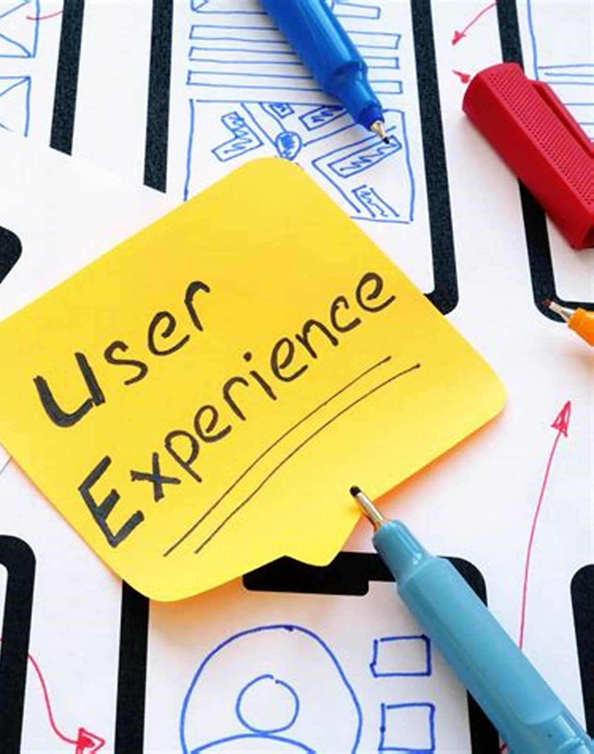
UI Design
Features :
Multimodal Input Support
Intelligent Summarization Options
Offline Spell Check and Grammar Enhancement
Security & Privacy (Encryption and Auto-Delete)
Voice-to-Text and Audio Summaries

Slide 10
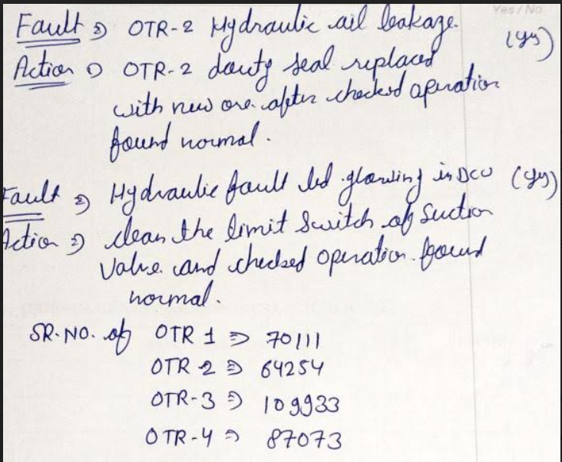
FOR THE FOLLOWING TEST CASE OUR OUTPUT WAS

Slide 11
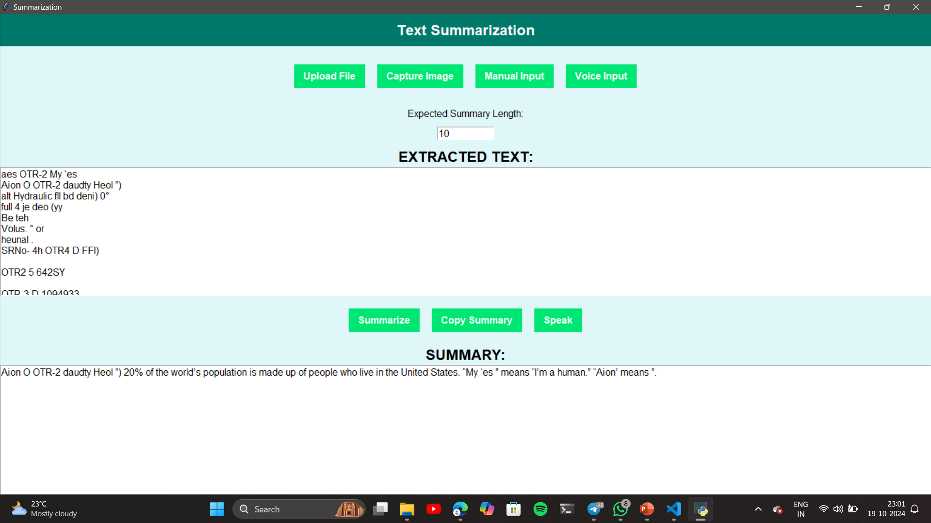

Slide 12
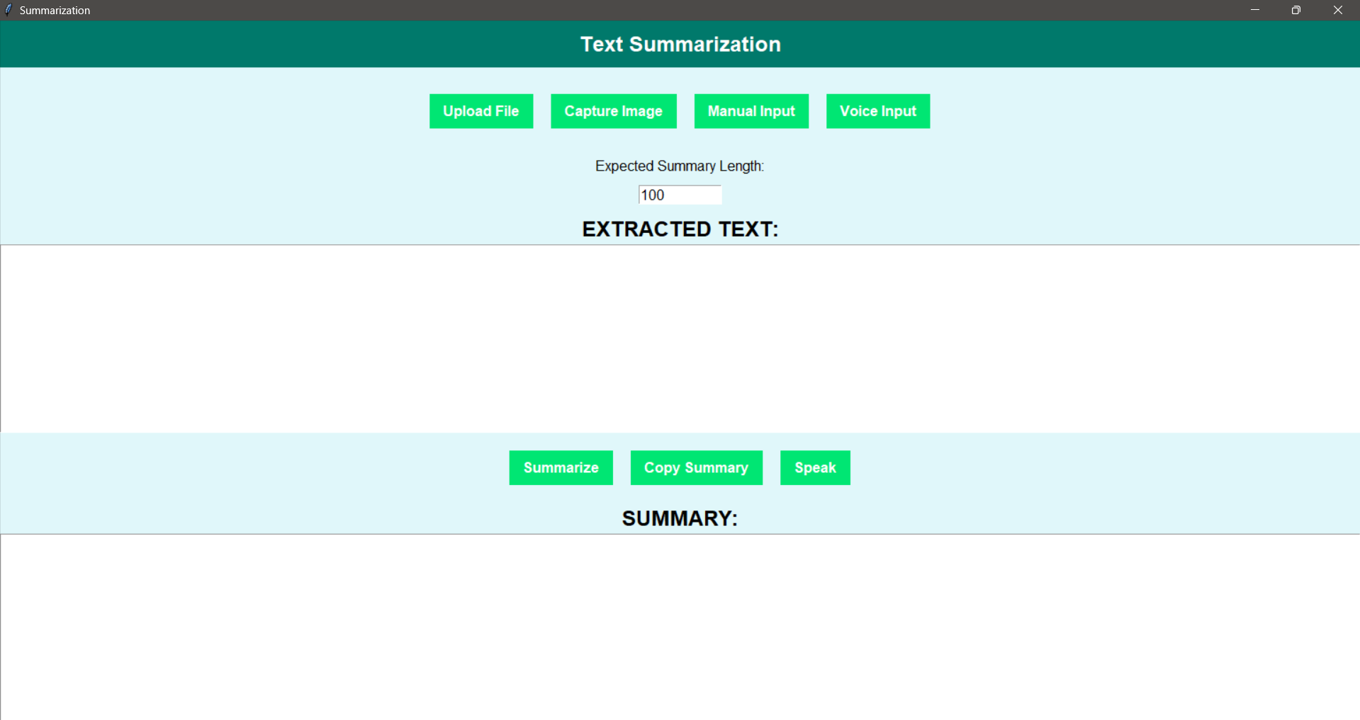
BASIC DESIGN OF OUR MODEL

Slide 13
THANK YOU

